Slide 1

ITT565 INTRODUCTION: NETWORK OPERATION SYSTEM AND ADMINISTRATION

Slide 2
Network Operating System Concepts
Definition of Network Operating System
Computer Network Models
The Roles of a System Administrator

Slide 3
Definition of Network Operating System (NOS)
Network operating system (NOS) is the software that allows multiple computers to communicate, share files and hardware devices with one another (ComputerHope, 2020).
It is an operating system that manages network resources that includes special functions for connecting computers and devices into a local area network (LAN).
The NOS manages multiple requests (inputs) concurrently and provides the security necessary in a multiuser environment.

Slide 4
What is network resources?
Shared resources, also known as network resources, refer to computer data, information, or hardware devices that can be easily accessed from a remote computer through a local area network (LAN) or enterprise intranet.
Successful shared resource access allows users to operate as if the shared resource were on their own computer.
The most frequently used shared network environment objects are files, data, multimedia and hardware resources like printers, fax machines and scanners.
https://www.techopedia.com/definition/24796/shared-resources

Slide 5
Examples of NOS
NetWare, Unix, Windows 2000, or Mac OS X require an existing operating system in order to function (e.g., Windows 3.11 for Workgroups requires DOS; LAN Server requires OS/2; LANtastic requires DOS).
In addition to file and print services, a NOS may also offer directory services and a messaging system (email), as well as network management and multiprotocol routing capabilities. (Indiana University Knowledge Base, 2020).

Slide 6
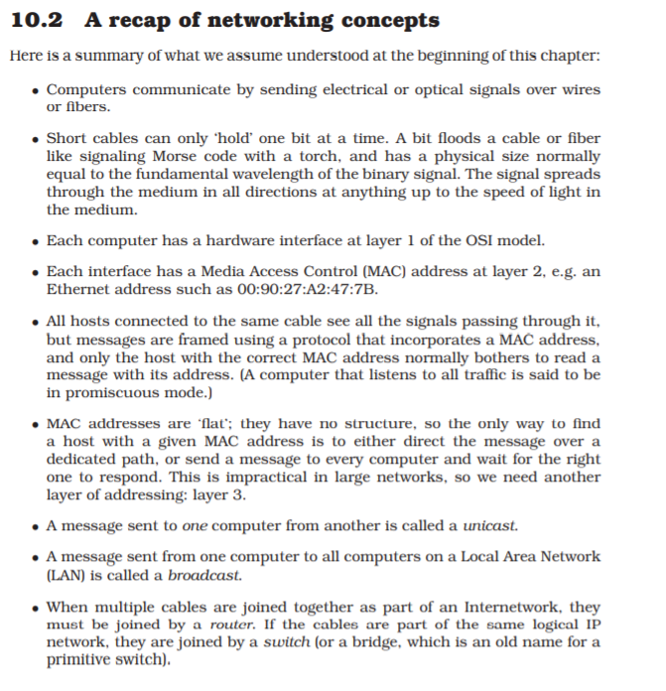
Networking concepts
Ref:
Mark Burgess (2004), Principles of Network and System Administration

Slide 7
Computer Network Models
A computer network consists software and hardware that is used to send and receive data from one device to another.
The role of hardware and software:
hardware is to prove the physical equipment that are required in order to send and receive data
software defines the set of instructions that uses the hardware equipment's for data transmission.
A simple transmission of data consists several steps at various layers of computer network.
Computer network models discusses:
how the data is transferred and received at a computer level in detail
https://beginnersbook.com/2019/04/computer-network-models/

Slide 8
Layers of a computer network models
The main purpose of having several layers in a computer network model is to divide a process of sending and receiving data into small tasks.
These layers are connected with each other,
Each layer provide certain data to its immediate higher and immediate lower layer and receives certain data from the same.
Dividing a model is layers makes the structure quite simple that makes it easy to identify the issue if it occurs.
https://beginnersbook.com/2019/04/computer-network-models/

Slide 9
Three main components of a computer network model.
Sender, receiver and carrier.
At sender Side: Higher layer: Higher layer serves the middle layer, directs the message (or data) to middle layer Middle layer: Middle layer picks up the data from higher layer and transfer it to the lower layer lower layer: The data is transmitted to the lower layer of the receiver side.
At receiver Side: lower layer: Receives the data from the lower layer of sender side and transfer it to middle layer. Middle layer: Middle layer picks up the data from lower layer and transfer to higher layer. Higher layer: Higher layer transfers the data to the receiver.

Slide 10
Model has different set and design of layers.
The most important computer network models are: 1. OSI Model 2. TCP/IP Model
https://beginnersbook.com/2019/04/computer-network-models/

Slide 11
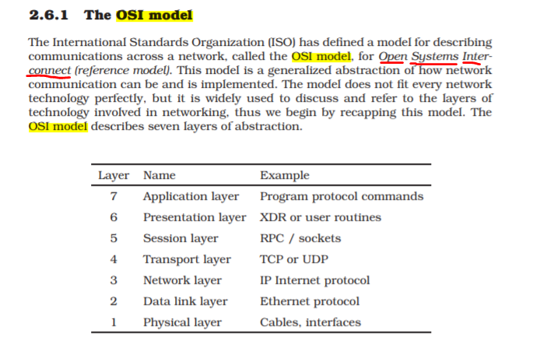
Ref:
Mark Burgess (2004), Principles of Network and System Administration

Slide 12
OSI model
1. OSI Model stands for Open System interconnection model. 2. OSI Model defines how data is transferred from one computer to another computer. 3. In a very basic scenario two computers connected with a LAN and connectors transfer data using the NIC. This forms a computer network, however if both the system uses different operating systems, for example one system runs on windows and other one runs on MacOS then how can data be transferred between these two different systems, here comes the role of a OSI model which is a seven layered model that defines how a data can be transferred between different systems.

Slide 13
OSI model
4. OSI model was introduced by International Organization for standardization (ISO) in 1984. 5. There are seven layers in a OSI model:
Layer 7 → Application layer
Layer 6 → Presentation Layer
Layer 5 → Session layer
Layer 4 → Transport layer
Layer 3 → Network Layer
Layer 2 → Data Link layer
Layer 1 → Physical layer

Slide 14
Summary of OSI layers
Layer 7 → Application layer→ protocols e.g. https, FTP, SMTP, DHCP etc
Layer 6 → Presentation Layer→ Translation, encryption, compression→ e.g. encryption, ASCII, PNG, MIDI
Layer 5 → Session layer → authentication, authorization, session management→e.g Syn/Ack
Layer 4 → Transport layer (data is in segments) → segmentation, flow control , flow control, error control, Connection oriented transmission, Connectionless transmission→ e.g TCP, UDP, port numbers
Layer 3 → Network Layer (data is in packets)→ logical address, routing, path determination (e.g. IP, routes
Layer 2 → Data Link layer (data is in frames) e.g MAC, switches
Layer 1 → Physical layer (data is in bits (1001011)) e.g cable: RJ45

Slide 15
Computer Network TCP/IP model
TCP/IP Reference Model is a four-layered suite of communication protocols. It was developed by the DoD (Department of Defense) in the 1960s. It is named after the two main protocols that are used in the model, namely, TCP (Transmission Control Protocol) and IP (Internet Protocol).
TCP/IP is a set of standardized rules that allow computers to communicate on a network such as the internet.
IP is the part that obtains the address to which data is sent.
TCP is responsible for data delivery once that IP address has been found.
https://www.tutorialspoint.com/ipv4/ipv4_tcpip_model.htm
https://www.avast.com/c-what-is-tcp-ip

Slide 16
Computer Network TCP/IP model
IP provides a mechanism to uniquely identify hosts by an IP addressing scheme. IP uses best effort delivery, i.e. it does not guarantee that packets would be delivered to the destined host, but it will do its best to reach the destination. Internet Protocol version 4 uses 32-bit logical address.
Think of it this way: The IP address is like the phone number assigned to your smartphone. TCP is all the technology that makes the phone ring, and that enables you to talk to someone on another phone.
They are different from one another, but they are also meaningless without one another.
https://www.tutorialspoint.com/ipv4/ipv4_tcpip_model.htm
https://www.avast.com/c-what-is-tcp-ip

Slide 17
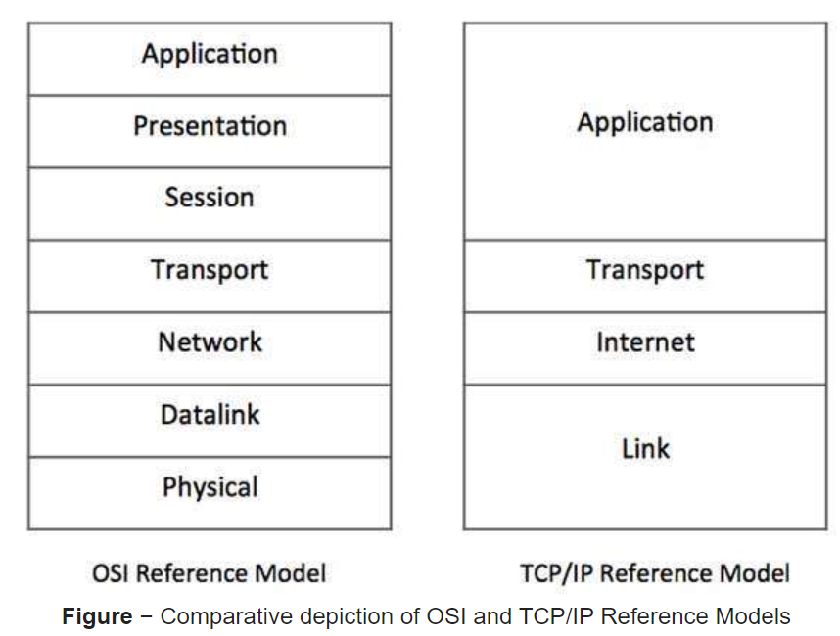
OSI MODEL versus TCP/IP
https://www.tutorialspoint.com/ipv4/ipv4_tcpip_model.htm

Slide 18
TCP/IP Model Layers
Application Layer
The Application Layer provides the user with the interface to communication. This could be your web browser, e-mail client (Outlook, Eudora or Thunderbird), or a file transfer client.
The Application Layer is where your web browser, a telnet, ftp, e-mail or other client application runs. Basically, any application that rides on top of TCP and/or UDP that uses a pair of virtual network sockets and a pair of IP addresses.
The Application Layer sends to, and receives data from, the Transport Layer.
https://upsir26.blogspot.com/search/label/Networking?m=0

Slide 19
TCP/IP Model Layers
Transport Layer
The Transport Layer provides the means for the transport of data segments across the Internet Layer. The Transport Layer is concerned with end-to-end (host-to-host) communication.
Transmission Control Protocol provides reliable, connection-oriented transport of data between two endpoints (sockets) on two computers that use Internet Protocol to communicate.
User Datagram Protocol provides unreliable, connectionless transport of data between two endpoints (sockets) on two computers that use Internet Protocol to communicate.
The Transport Layer sends data to the Internet layer when transmitting and sends data to the Application Layer when receiving.
https://upsir26.blogspot.com/search/label/Networking?m=0

Slide 20
TCP/IP Model Layers
Internet Layer
The Internet Layer provides connectionless communication across one or more networks, a global logical addressing scheme and packetization of data. The Internet Layer is concerned with network to network communication.
The Internet Layer is responsible for packetization, addressing and routing of data on the network. Internet Protocol provides the packetization, logical addressing and routing functions that forward packets from one computer to another.
The Internet Layer communicates with the Transport Layer when receiving and sends data to the Network Access Layer when transmitting.
https://upsir26.blogspot.com/search/label/Networking?m=0

Slide 21
TCP/IP Model Layers
Network Access Layer
The Network Access Layer provides access to the physical network.
This is your network interface card. Ethernet, FDDI, Token Ring, ATM, OC, HSSI, or even Wi-Fi are all examples of network interfaces. The purpose of a network interface is to allow your computer to access the wire, wireless or fiber optic network infrastructure and send data to other computers.
The Network Access Layer transmits data on the physical network when sending and transmits data to the Internet Layer when receiving.
https://upsir26.blogspot.com/search/label/Networking?m=0

Slide 22
All Internet-based applications and their data, whether it is a web browser downloading a web page, Microsoft Outlook sending an e-mail, a file, an instant message, a Skype video or voice call;
the data is chopped into data segments and encapsulated in Transport Layer Protocol Data Units or PDU's (TCP or UDP segments).
The Transport Layer PDU's are then encapsulated in Internet Layer's Internet Protocol packets.
The Internet Protocol packets are then chopped into frames at the Network Access layer and transmitted across the physical media (copper wires, fiber optic cables or the air) to the next station in the network.
https://upsir26.blogspot.com/search/label/Networking?m=0

Slide 23
The Roles of a System Administrator
Account Provisioning → add account for new users , remove for in active staff and handles all issues relating to account.
Adding and removing hardware
Performing backups
Installing and upgrading software
Monitoring the system
Troubleshooting
Maintaining local documentation
Monitoring security → implement security policy, periodically check security is not violated, evaluate network trap and audit the security system

Slide 24
The End

